Slide 1

Development of Machine Learning Assisted Surrogate Models for Complex Space Structures
Grace Morris
Department of Mechanical Engineering Northern Arizona University
Advsior: Prof. Subhayan De
April 20, 2024
Arizona Space Grant 2024 Symposium

Slide 2
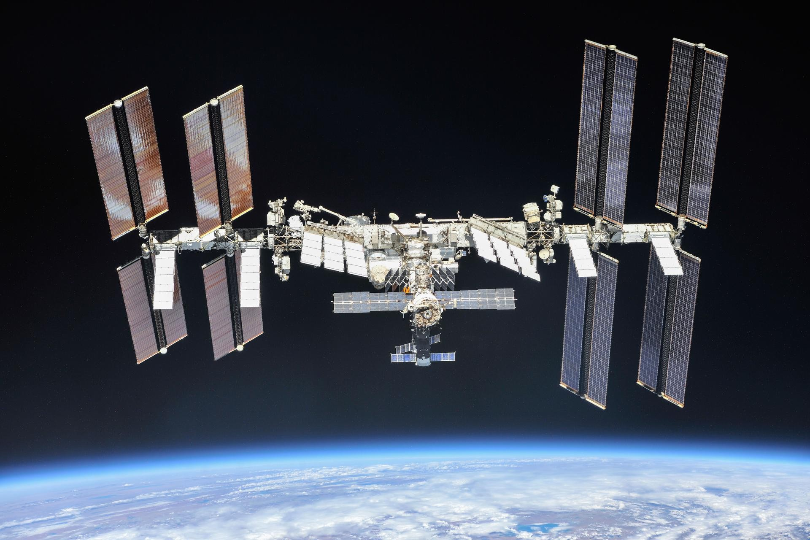
Motivation and Objective
1
Motivation:
Complex space structures, like the International Space Station, have several components that can show complicated behavior.
In addition, there are ubiquitous presence of uncertainty in material properties, and loading.
Surrogate models and various machine-learning tools can be used to represent the behavior of these structures in a computationally efficient manner.
Objective:
Develop a finite element model of components of the International Space Station using available specifications.
Generate training dataset to develop machine learning-assisted surrogate models.
Source: NASA

Slide 3
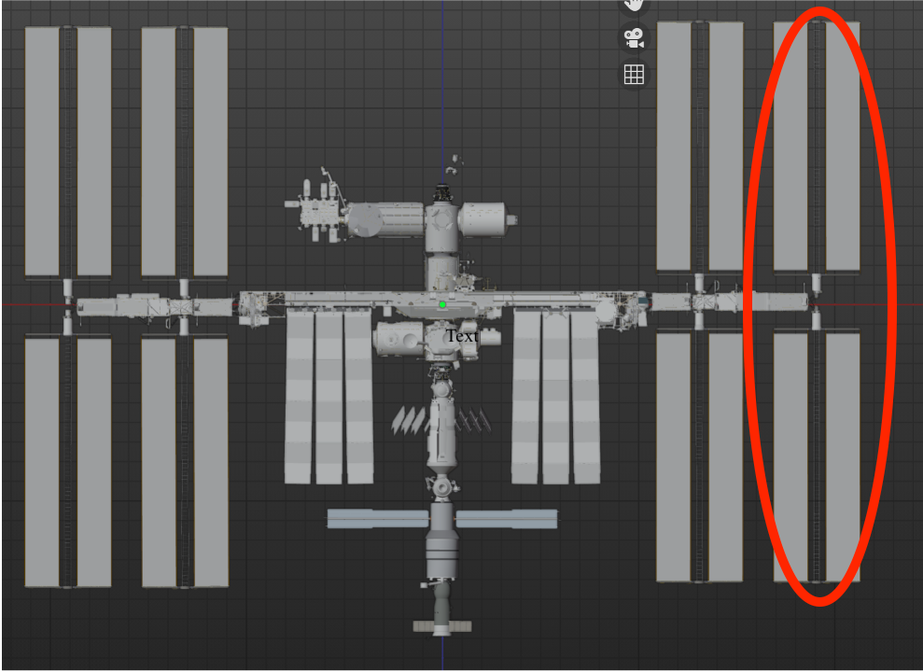
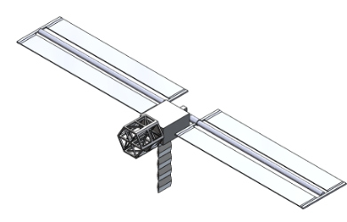
Physical Model
2
Density-based TO:
A Solidworks model of the ISS is created using specifications from a blender model available on the NASA website.
Solidworks model
Blender model, Source: NASA

Slide 4
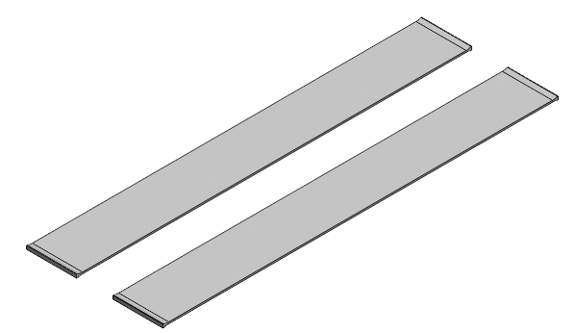
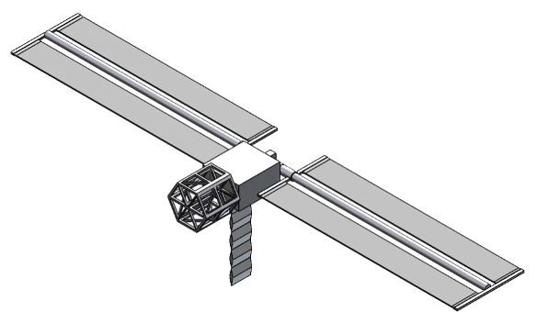
Material Assignment
3
For the metal components 2219 aluminum alloy is used. For the solar panels gallium arsenide is used.
Gallium arsenide is the primary component in the solar panels used in space because it increases the efficiency of the panels when compared to other materials.
Solar panels actually contain several thin layers of different materials and electronics.
References:
"Columbus: Europe’s Laboratory on the International Space Station." ESA. Retrieved 23 August 2021.
NASA JPL Publication: Basics of Space Flight, Chapter 11. Typical Onboard Systems, Electrical Power Supply and Distribution Subsystems, "Basics of Space Flight Section II. Space Flight Projects."

Slide 5
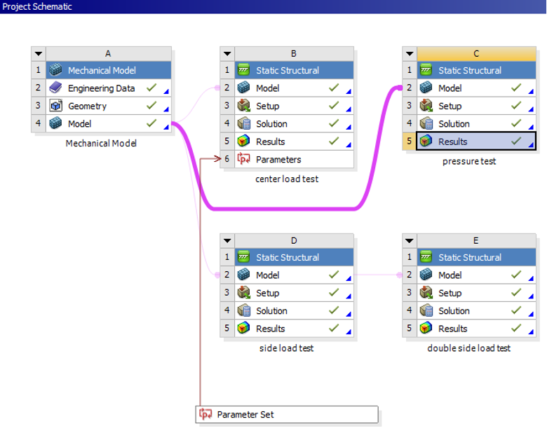
Finite Element Analysis
4
ANSYS workbench and mechanical are used to perform the finite element analysis of the model.

Slide 6
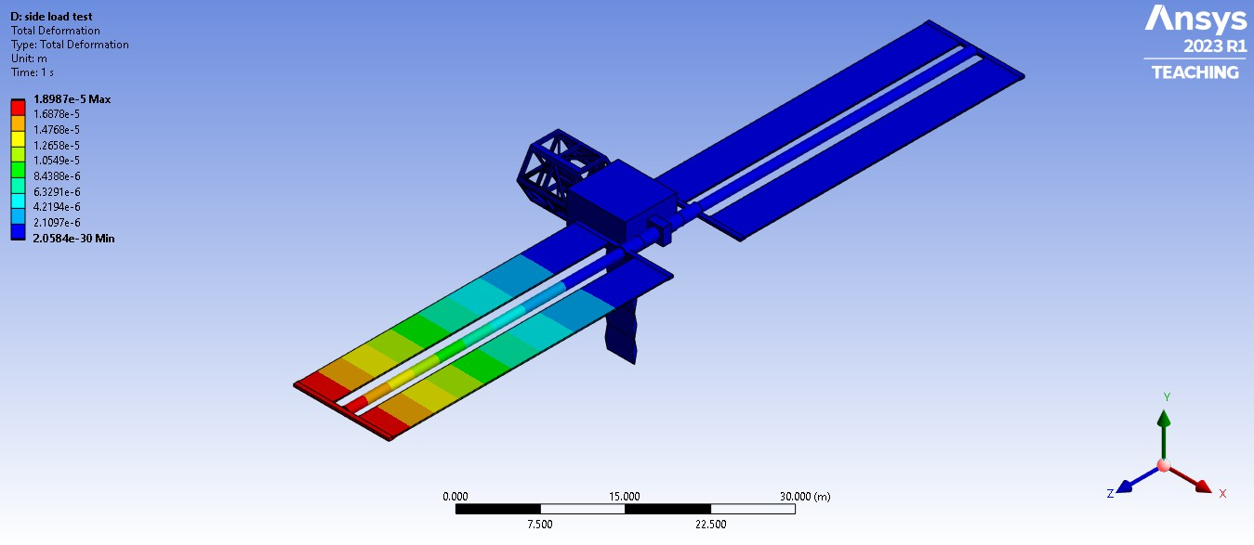
Finite Element Analysis
5

Slide 7
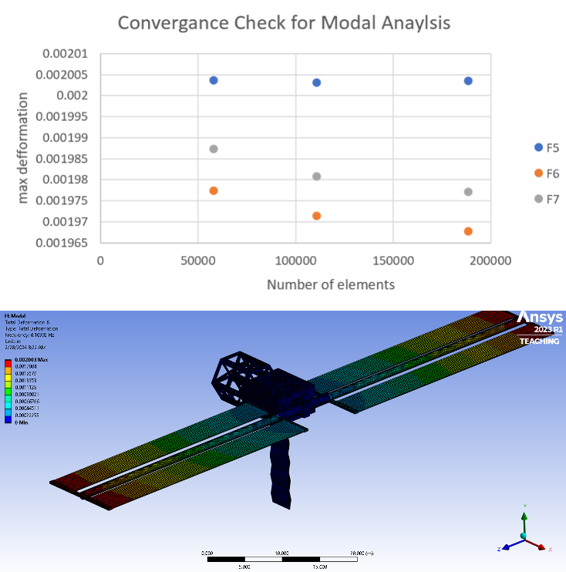
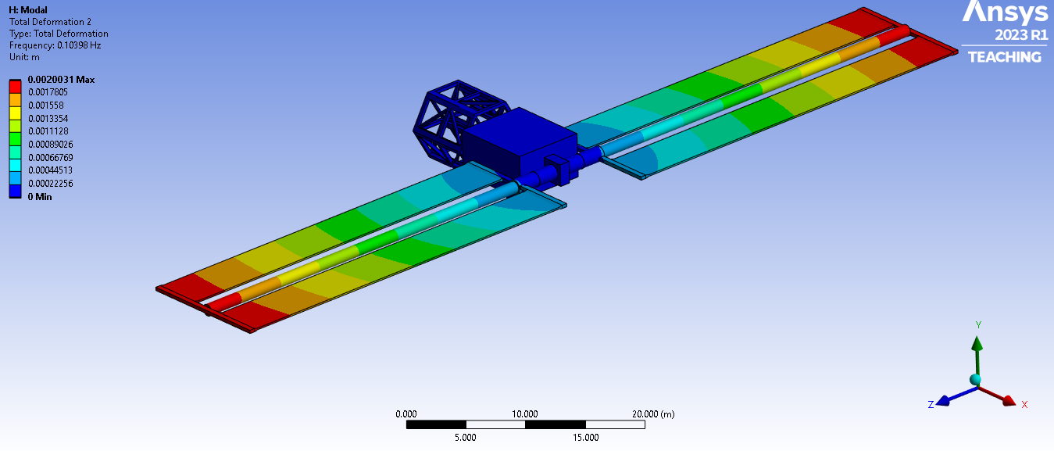
Natural Frequencies and Mode Shapes
6
Natural frequencies and mode shapes are important to consider for dynamic analysis.

Slide 8
Material Uncertainty
7
To generate the training dataset, random samples are generated for the material properties from the following distributions.
 | 2219 Aluminium Alloy |  |  | Gallium | Arsenide
 | Distribution | Mean | CV | Distribution | Mean | CV
E [GPa] | lognormal | 71.3 | 0.1 | lognormal | 85.7 | 0.1
ν | lognormal | 0.34 | 0.1 | lognormal | 0.31 | 0.1
G [GPa] | lognormal | 26.1 | 0.1 | lognormal | 32.7 | 0.1

Slide 9
Conclusions and Ongoing Work
8
For complex space structures, developing surrogate models can significantly reduce the computational burden for future analysis.
The effects of uncertainty in the material properties has also been incorporated.
Training of a Bayesian Neural Network and a Variational Autoencoder, two artificial neural network architectures with inherent capability to represent the underlying uncertainty, to model the natural frequencies and mode shapes, respectively, is ongoing.

Slide 10
THANK YOU
8
Acknowledgment: This work was supported by the internship program from the Northern Arizona University NASA Space Grant.

